Slide 1
Economics of Platforms

Slide 2
What is a Platform?
Narrow definition: intermediary that “makes a market” to bring together buyers and sellers
  NYSE/Nasdaq exchanges for public equities
  eBay or Amazon’s e-commerce platforms
  Apple’s “app store” for developers and consumers.
  Google’s “ad platform” for websites and advertisers
Broader: intermediary that brings together groups of users to facilitate economic or social exchange
  Payment networks: Visa, Mastercard, Paypal
  Social platforms: Facebook, Twitter, Match.com.
  Media (papers, websites): advertisers, consumers, content.

Slide 3
Network Effects
Key idea in the economic analysis of platforms is that they are characterized by network effects
Examples
  Developers want to create products for Windows, iPhone, Android because of consumer base. Consumers are attracted in part because of the applications.
  People want to have Visa cards because they are widely accepted, and merchants want to accept them because most people have them.
  Traders want to trade in markets where they can easily find counter-parties, and where the market is liquid.

Slide 4
Outline
Economics of network effects (today)
  Modeling network effects. The chicken/egg problem. Competing platforms and “lock-in”. Optimal platform pricing with network effects.
Marketplace/platform design (next few lectures)
  Marketplaces (e-commerce and peer-to-peer): organizing search to create matches, reputation systems, promoting competition and good behavior.
  Athey guest lecture on bitcoin and digital currencies.

Slide 5
Network Effects Model
Single platform with N potential users.
Each consumer’s value for platform depends on
  Intrinsic value: b (differs across consumers)
  Price charged by platform: p
  Number of other users: f(n)
Consumer value: b – p + f(n)
Platform sets price, then potential users make individual decisions to participate or not. Number of users n is determined as a Nash equilibrium.

Slide 6
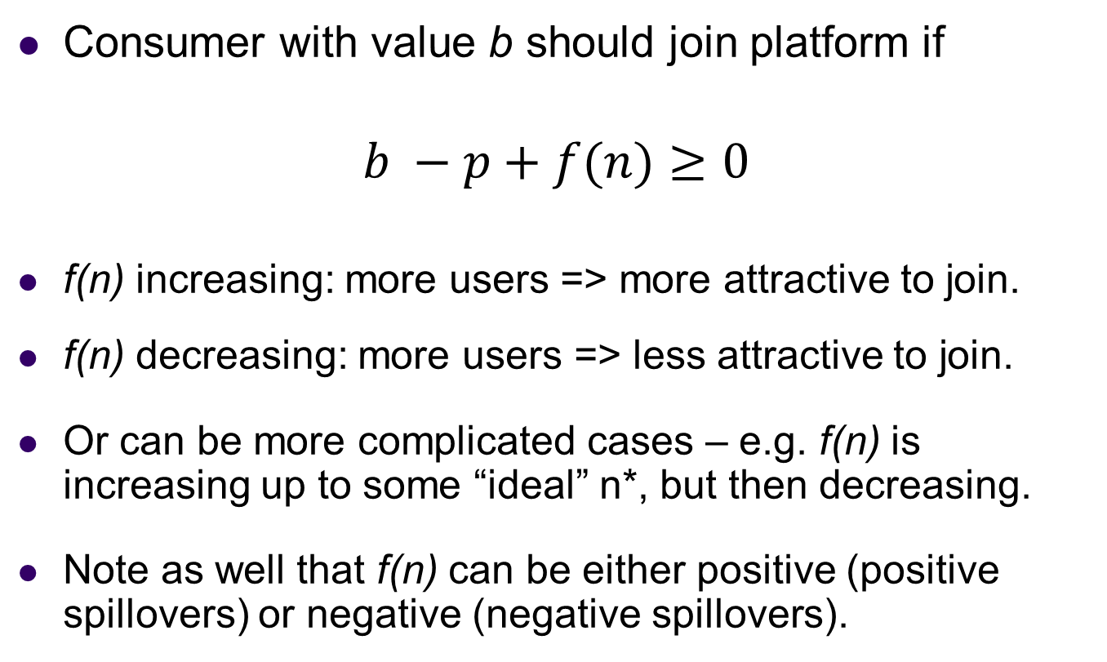
Network Effects
Consumer with value b should join platform if
$$b −p+f(n)≥0$$
f(n) increasing: more users => more attractive to join.
f(n) decreasing: more users => less attractive to join.
Or can be more complicated cases – e.g. f(n) is increasing up to some “ideal” n*, but then decreasing.
Note as well that f(n) can be either positive (positive spillovers) or negative (negative spillovers).

Slide 7
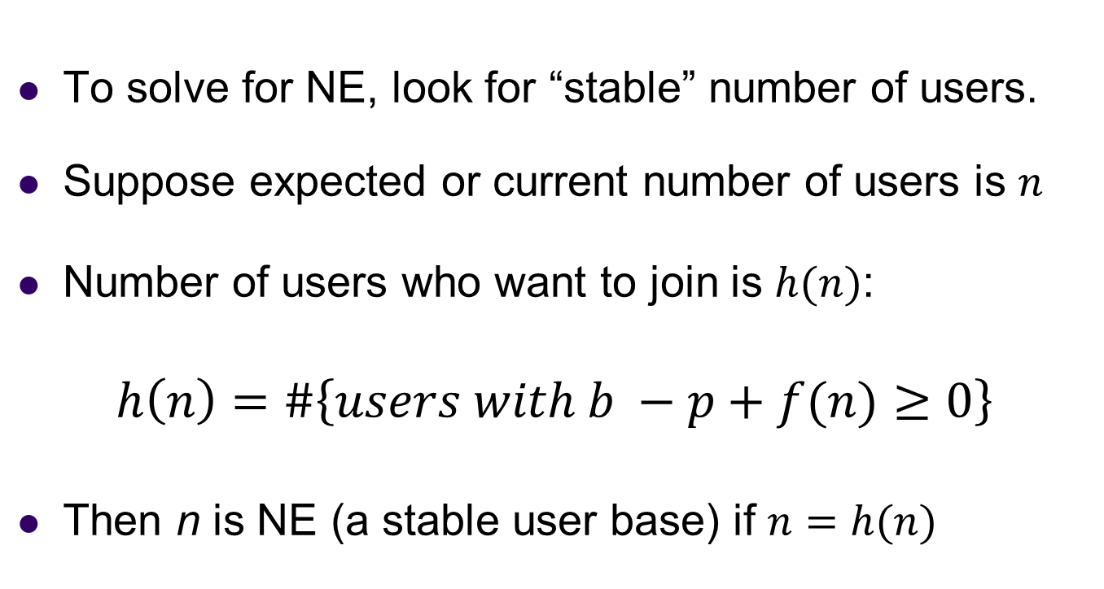
Network Effects
To solve for NE, look for “stable” number of users.
Suppose expected or current number of users is $n$
Number of users who want to join is $h(n)$:
$$h\left(n\right)=\#\left\{users with b −p+f(n)≥0\right\}$$
Then n is NE (a stable user base) if $n=h(n)$

Slide 8
Network Effects: Example
Let’s try a specific example
b’s are distributed U[0,1] in population
p is fixed at p=3/4
Specification of network effects
  f(n)=0 if n<N/2
  f(n)=1/2 if n>N/2.

Slide 9
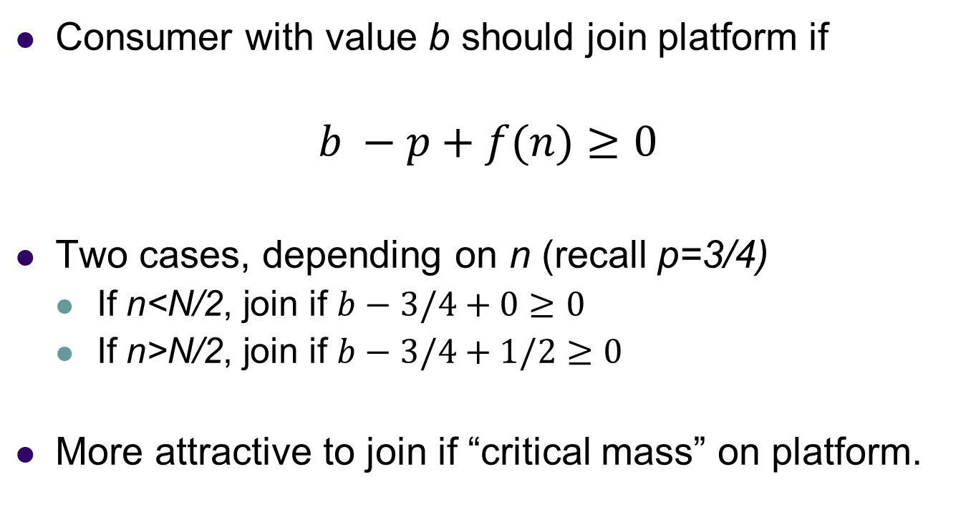
Network Effects: Example
Consumer with value b should join platform if
$$b −p+f(n)≥0$$
Two cases, depending on n (recall p=3/4)
  If n<N/2, join if $b−3/4+0$ $≥0$
  If n>N/2, join if $b−3/4+1/2≥0$
More attractive to join if “critical mass” on platform.

Slide 10
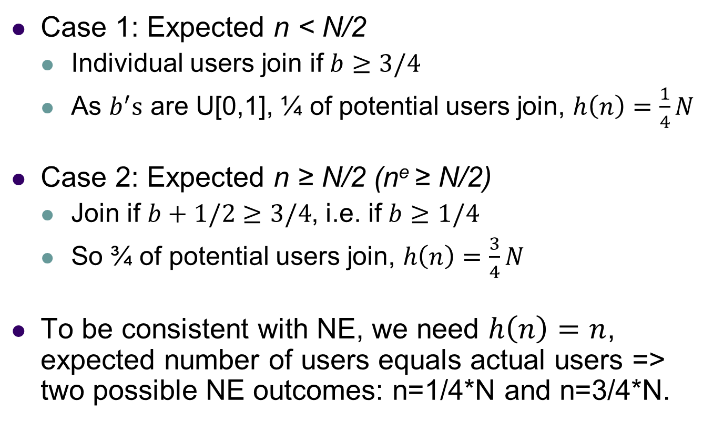
Network Effects
Case 1: Expected n < N/2
  Individual users join if $b≥3/4$
  As $b^{′}s$ are U[0,1], ¼ of potential users join, $h\left(n\right)=\frac{1}{4}N$
Case 2: Expected n ≥ N/2 (n^{e} ≥ N/2)
  Join if $b+1/2≥3/4$, i.e. if $b≥1/4$
  So ¾ of potential users join, $h\left(n\right)=\frac{3}{4}N$
To be consistent with NE, we need $h\left(n\right)=n$, expected number of users equals actual users => two possible NE outcomes: n=1/4*N and n=3/4*N.

Slide 11

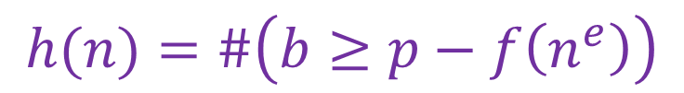
Network Effects
Actual f(n)
$$h\left(n\right)=n$$
N
Stability (NE)
High Use Eqm
3N/4
N/2
$$h(n)=\#\left(b≥p−f\left(n^{e}\right)\right)$$
Purple line shows optimal participation as response to expected participation.
N/4
Low Use Eqm
0
N/4
N/2
3N/4
N
Expected n

Slide 12
Additional Examples
Some alternatives
  Linear model: f(n) = an (more users – better platform)
  Congestion model: f(n) = -bn² (platform gets crowded)
  “Bliss point” model: f(n) = an - n²/2 (maximized at n=a)

Slide 13
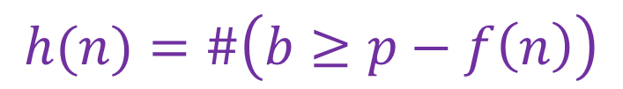
Network Effects
Actual h(n)
$$h\left(n\right)=n$$
N
Stability (NE)
3N/4
Positive feedback
N/2
$$h(n)=\#\left(b≥p−f\left(n\right)\right)$$
Purple lines shows optimal participation as response to expected participation.
N/4
Congestion
0
N/4
N/2
3N/4
N
Expected n

Slide 14
Some results
Result 1. Unique or multiple equilibria.
If f(n) is decreasing, there will be a unique NE.
If f(n) is increasing, then there is the potential (but not the necessity) for multiple Nash equilibria.
Result 2. Effect of price and values.
An increase in consumer values (the “b”s) will increase the number of users in the NE with the most users.
An increase in p will decrease the number of users in the NE with the greatest number of users.

Slide 15
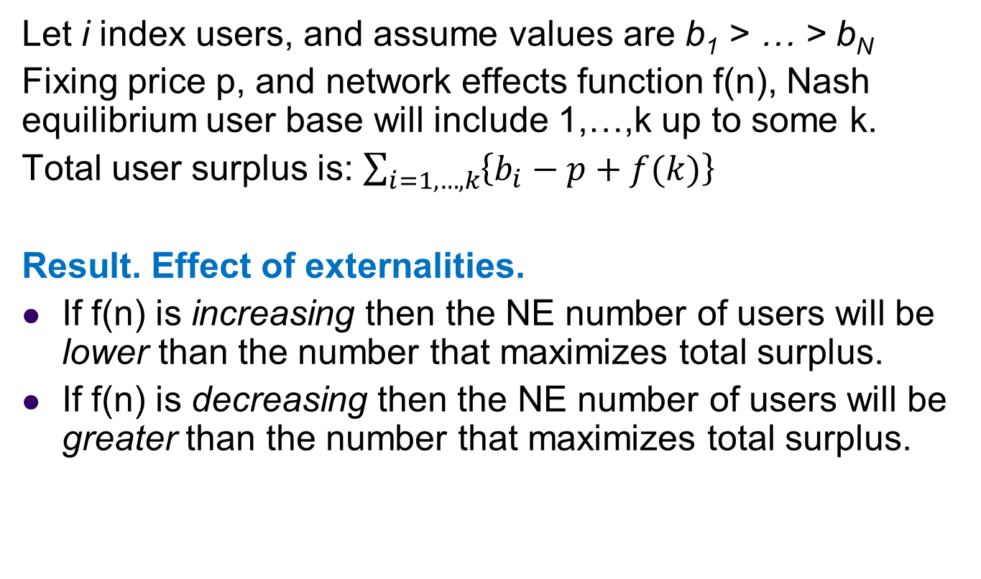
Positive/Negative Spillovers
Let i index users, and assume values are b₁ > … > b_{N}
Fixing price p, and network effects function f(n), Nash equilibrium user base will include 1,…,k up to some k.
Total user surplus is: $\sum_{i=1,…,k}{\left\{b_{i}−p+f(k)\right\}}$
Result. Effect of externalities.
If f(n) is increasing then the NE number of users will be lower than the number that maximizes total surplus.
If f(n) is decreasing then the NE number of users will be greater than the number that maximizes total surplus.

Slide 16
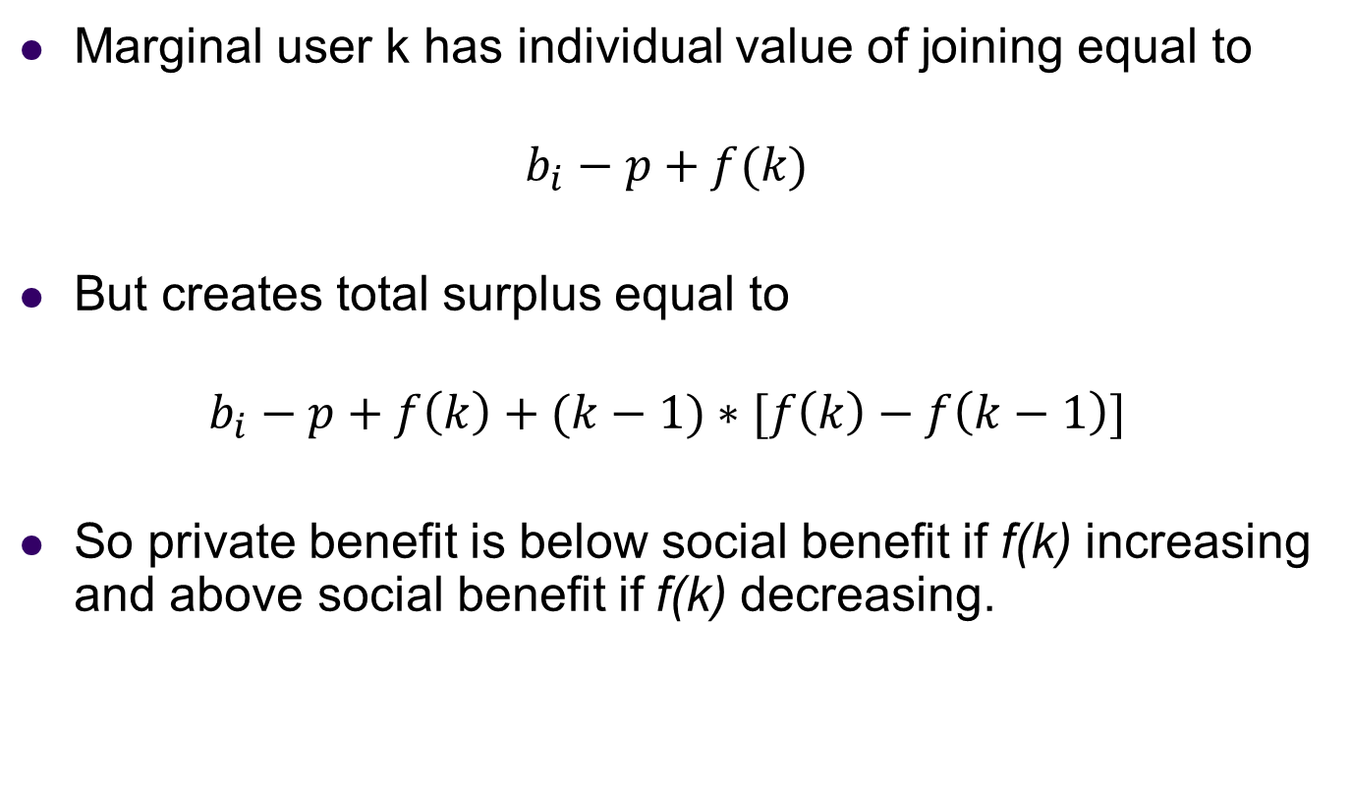
Proof
Marginal user k has individual value of joining equal to
$$b_{i}−p+f(k)$$
But creates total surplus equal to
$$b_{i}−p+f\left(k\right)+(k−1)∗[f\left(k\right)−f\left(k−1\right)]$$
So private benefit is below social benefit if f(k) increasing and above social benefit if f(k) decreasing.

Slide 17
Richer network effects
Multiple user groups makes richer patterns possible.
Newspapers, television or ad-supported websites
  More readers make platform more attractive to advertisers
  More readers make platform more attractive to content creators
  More content and less advertising may make platform less attractive to users.
Buyer-seller or matching marketplaces
  More buyers can make market more attractive to sellers
  More sellers can make market more attractive to buyers
  Scaling up the number of buyers and sellers, holding proportions fixed, can sometimes make a market more attractive, but it doesn’t necessarily have to.

Slide 18
Platform Competition
Typical concern about platform markets is that people will coordinate on a “dominant” platform.
  Competition between platforms may be “winner-take-all” (eBay in online auctions, Google in search).
Over time, new platforms may find it difficult to enter against an existing platform with a strong user base.
  Potential for dynamic inefficiency: people would switch if they thought others would switch, but …
  Example: might be possible to have a better operating system than Windows, but hard to convert people because of existing applications and user base.

Slide 19
Platform Competition: Model
Suppose there are now two platforms: A,B
  Consumers distributed on “Hotelling line” between A and B, with A located at 0, B located at 1.
  Consumer at b has intrinsic benefit b for B, and intrinsic benefit a=1-b for A.
  Let G denote the cdf of consumer locations: so G(x) is the fraction of consumers with b<x.
Network effects: benefit f(n)=kn from joining a platform that has fraction n of consumers.
Consumers must choose a single platform, and both platform prices fixed at p, so price not a factor.

Slide 20
Distribution of Preferences
Users mostly indifferent
Uniform distribution of tastes
Strong bases
0
1

Slide 21
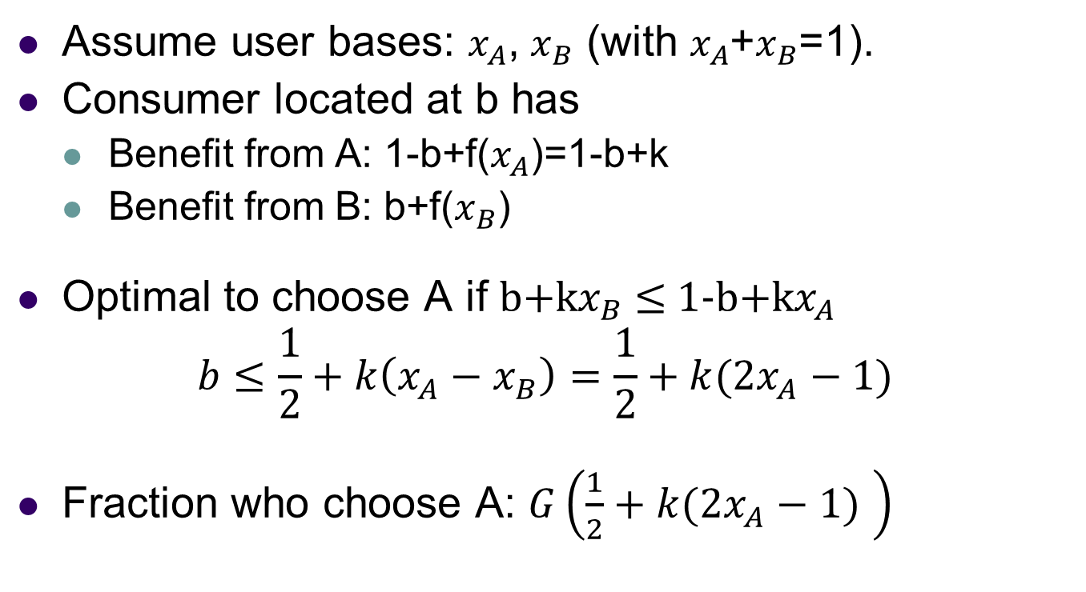
Competing Platforms
Assume user bases: $x_{A}^{}$, $x_{B}^{}$ (with $x_{A}^{}$+$x_{B}^{}$=1).
Consumer located at b has
  Benefit from A: 1-b+f($x_{A}^{}$)=1-b+k
  Benefit from B: b+f($x_{B}^{}$)
Optimal to choose A if b+k$x_{B}$ $≤$ 1-b+k$x_{A}$
$$b≤\frac{1}{2}+k\left(x_{A}^{}−x_{B}^{}\right)=\frac{1}{2}+k(2x_{A}^{}−1)$$
Fraction who choose A: $G\left(\frac{1}{2}+k(2x_{A}^{}−1) \right)$

Slide 22
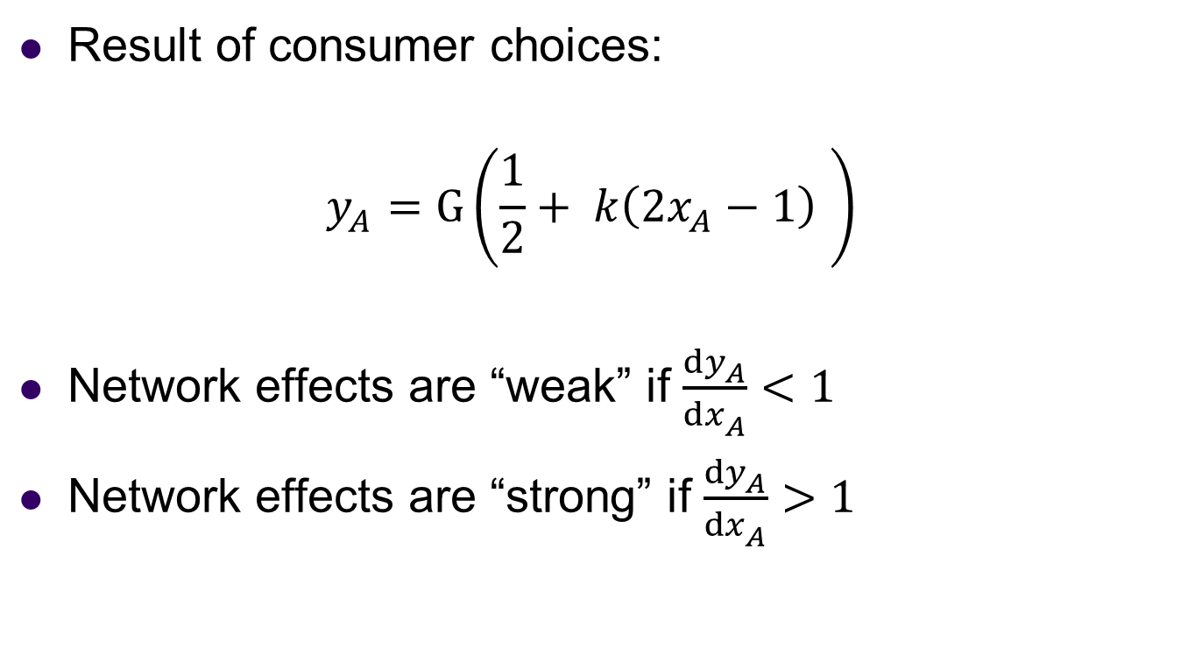
Competing Platforms
Result of consumer choices:
$$y_{A}^{}=G\left(\frac{1}{2}+ k\left({2x}_{A}^{}−1\right) \right)$$
Network effects are “weak” if $\frac{dy_{A}^{}}{dx_{A}^{}}<1$
Network effects are “strong” if $\frac{dy_{A}^{}}{dx_{A}^{}}>1$

Slide 23

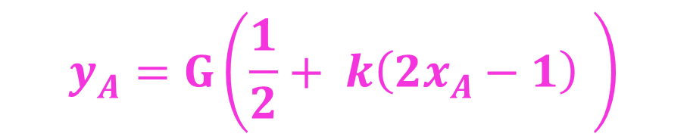
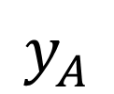
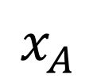
Weak network effects
$$y_{A}^{}$$
$$y_{A}^{}=x_{A}^{}$$
1
Stability (NE)
$$y_{A}^{}=G\left(\frac{1}{2}+ k\left({2x}_{A}^{}−1\right) \right)$$
0
$$x_{A}^{}$$
0
1

Slide 24
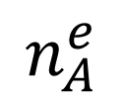
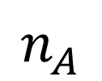
Strong network effects
$$n_{A}^{}$$
$$y_{A}^{}=x_{A}^{}$$
1
$$y_{A}^{}=G\left(\frac{1}{2}+ k\left({2x}_{A}^{}−1\right) \right)$$
0
$$n_{A}^{e}$$
0
1

Slide 25

Strong network effects
$$n_{A}^{}$$
1
$$y_{A}^{}=x_{A}^{}$$
$$y_{A}^{}=G\left(\frac{1}{2}+ k\left({2x}_{A}^{}−1\right) \right)$$
0
$$n_{A}^{e}$$
0
1

Slide 26
Potential for Inefficiency
Equilibria can have very different welfare properties.
Extreme case: all consumers has intrinsic benefit b=1 from B and a=0 for A, but k=2, so strong network effect.
There are multiple equilibria
  Everyone chooses A: given this, all consumers derive value 2 from A, value 1 from B, choosing A is optimal.
  Everyone chooses B: given this, all consumers derive value 0 from A, value 3 from B, choosing B is optimal.
Everyone using B is better for everyone, but no guarantee that we end up at this equilibrium.

Slide 27
Dominant Platforms
What factors might contribute to a having a single dominant platform, or make entry difficult?
Strong (positive) network effects
High costs of switching or “multi-homing”
Economies of scale
Note: scale economies can take different forms
  Google engineers write same algorithms as Bing engineers, but algorithms are used for 65% of searchers.
  Google has more searchers, so better data on what people want to see, so able to write better algorithms.

Slide 28
Platform Pricing
What is the optimal way to price platform use in the presence of network effects?
What side to charge: one side, both sides?
  Common to charge one side of the market: e.g. Google charges advertisers, not consumers, Visa, eBay charge sellers not buyers, auction houses….
How to optimally trade off efficiency vs profit?
  Expanding the user base can create value, but may mean lower prices that reduce profit.
What if there is competition between platforms?

Slide 29
Platform Pricing Model
Single platform, single group of users.
First-pass approach to modeling:
  Platform sets price p
  Users decide whether to sign up
  Complication: what if there are multiple equilibria?
Useful approach: work with quantities, not prices
  Platform chooses target user base x
  If x is consistent with NE for some price p, focus on the (maximum) price at which x is a NE for the users.
  Implicitly, platform can solve coordination problem.

Slide 30
Coordinating Users
Why might a platform be able to coordinate users?
Consider earlier example
  Users with intrinsic value b, distributed U[0,1]
  Network benefit of 1/2 if and only if n≥1/2
  If platform sets p=3/4, there are two equilibria: n=1/4, and n=3/4, with low and high usage.
Strategy for ensuring the high equilibrium
  Platform says: p=3/4 so long as n≥1/2, but if n<1/2, then will lower price to p=1/4!

Slide 31
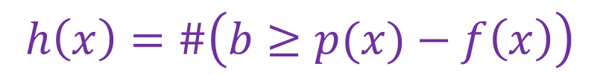

Coordinating Users
h(x)
$$h(x)=x$$
N
3/4
1/2
$$h\left(x\right)=\#\left(b≥p(x)−f\left(x\right)\right)$$
1/4
0
N/4
N/2
3/4
N
x

Slide 32
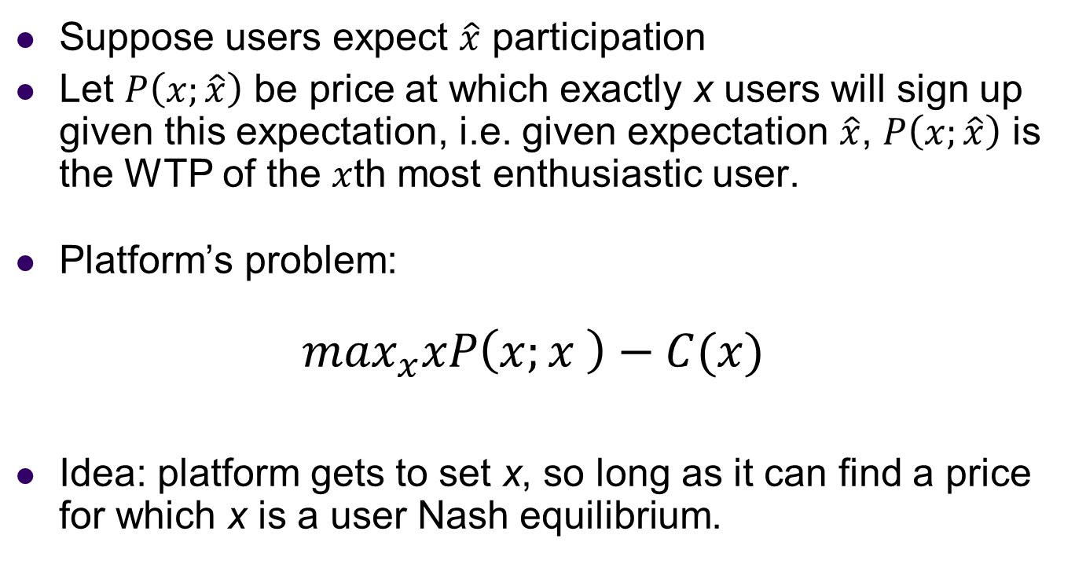
Pricing Problem
Suppose users expect $\hat{x}$ participation
Let $P\left(x;\hat{x}\right)$ be price at which exactly x users will sign up given this expectation, i.e. given expectation $\hat{x}$, $P\left(x;\hat{x}\right)$ is the WTP of the $x$th most enthusiastic user.
Platform’s problem:
$$\max_{x}xP\left(x;x \right)−C(x)$$
Idea: platform gets to set x, so long as it can find a price for which x is a user Nash equilibrium.

Slide 33


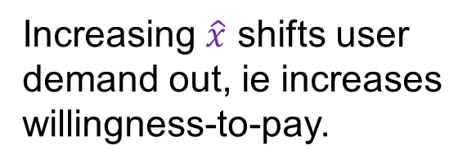
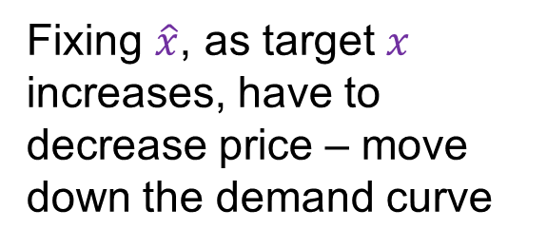
Demand Curves
P
Fixing $\hat{x}$, as target $x$ increases, have to decrease price – move down the demand curve
$$P\left(x;\hat{x}\right)$$
Increasing $\hat{x}$ shifts user demand out, ie increases willingness-to-pay.
$$P\left(x;\hat{x}\right)$$
0
0
x

Slide 34
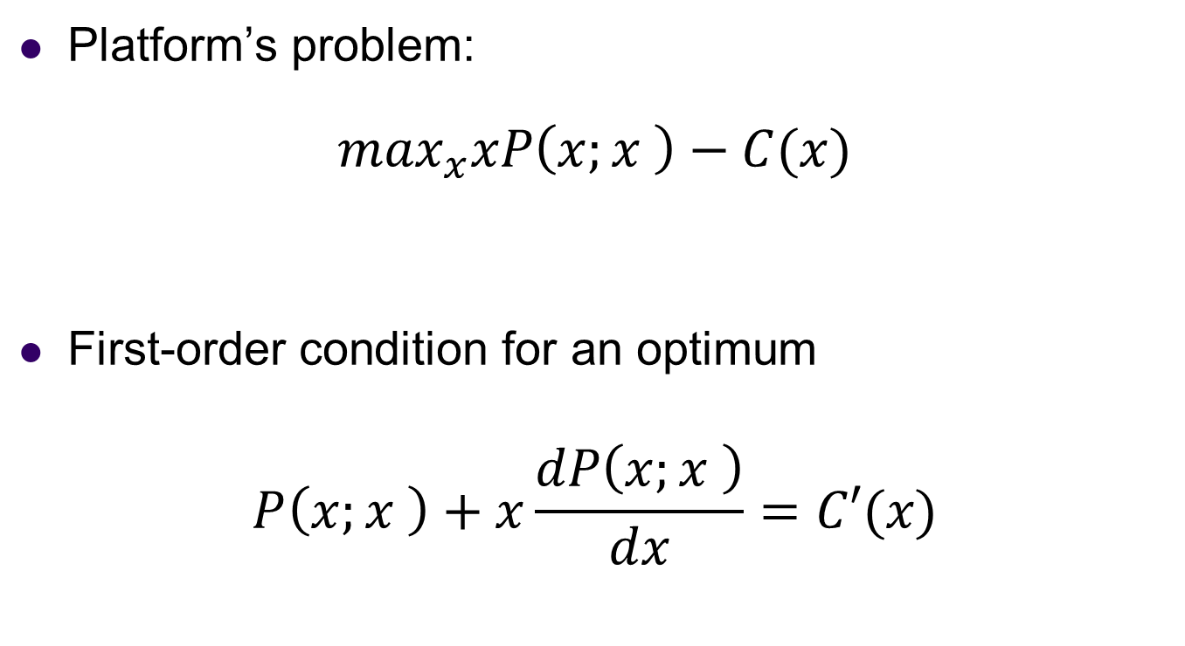
Optimal Pricing
Platform’s problem:
$$\max_{x}xP\left(x;x \right)−C(x)$$
First-order condition for an optimum
$$P\left(x;x \right)+x\frac{dP\left(x;x \right)}{dx}=C′(x)$$

Slide 35
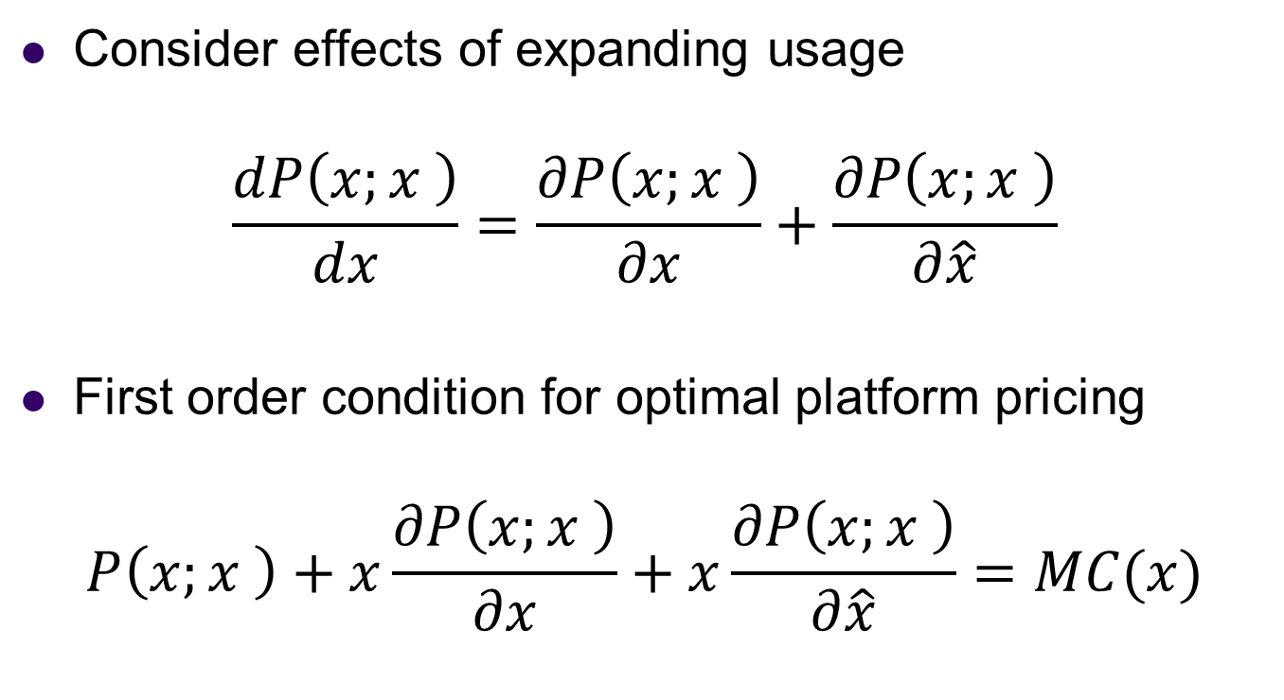
Optimal Pricing, cont.
Consider effects of expanding usage
$$\frac{dP\left(x;x \right)}{dx}=\frac{∂P\left(x;x \right)}{∂x}+\frac{∂P\left(x;x \right)}{∂\hat{x}}$$
First order condition for optimal platform pricing
$$P\left(x;x \right)+x\frac{∂P\left(x;x \right)}{∂x}+x\frac{∂P\left(x;x \right)}{∂\hat{x}}=MC(x)$$

Slide 36
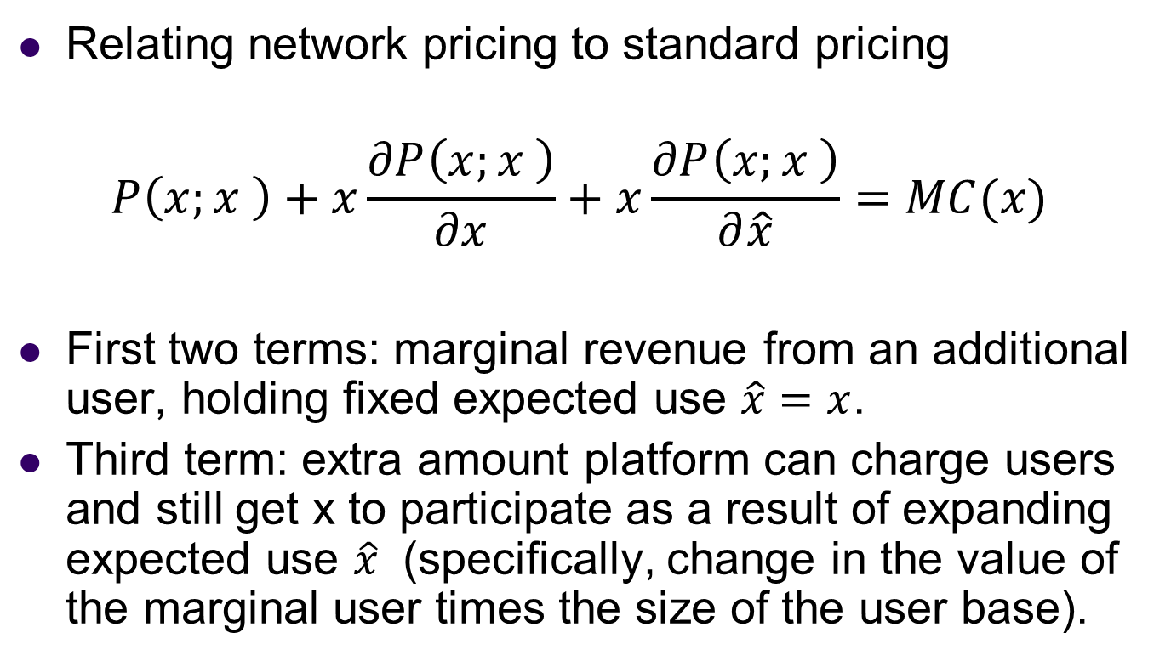
Optimal Pricing, cont.
Relating network pricing to standard pricing
$$P\left(x;x \right)+x\frac{∂P\left(x;x \right)}{∂x}+x\frac{∂P\left(x;x \right)}{∂\hat{x}}=MC(x)$$
First two terms: marginal revenue from an additional user, holding fixed expected use $\hat{x}=x$.
Third term: extra amount platform can charge users and still get x to participate as a result of expanding expected use $\hat{x}$ (specifically, change in the value of the marginal user times the size of the user base).

Slide 37
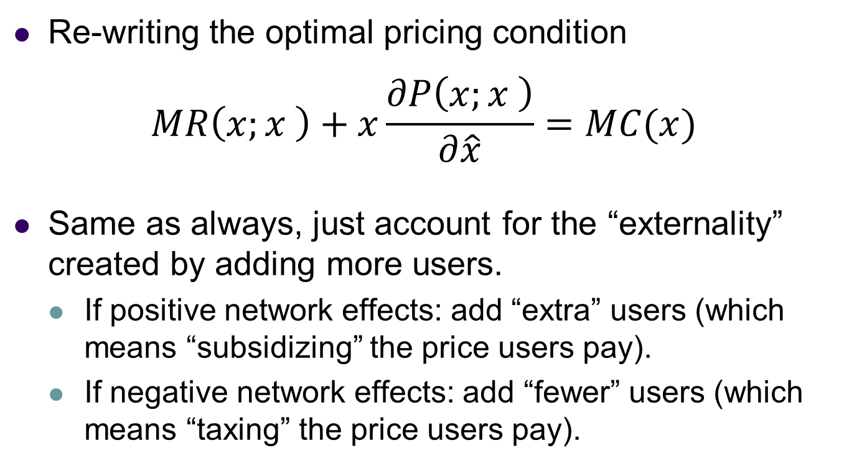
Connect to Standard Pricing
Re-writing the optimal pricing condition
$$MR\left(x;x \right)+x\frac{∂P\left(x;x \right)}{∂\hat{x}}=MC(x)$$
Same as always, just account for the “externality” created by adding more users.
  If positive network effects: add “extra” users (which means “subsidizing” the price users pay).
  If negative network effects: add “fewer” users (which means “taxing” the price users pay).

Slide 38
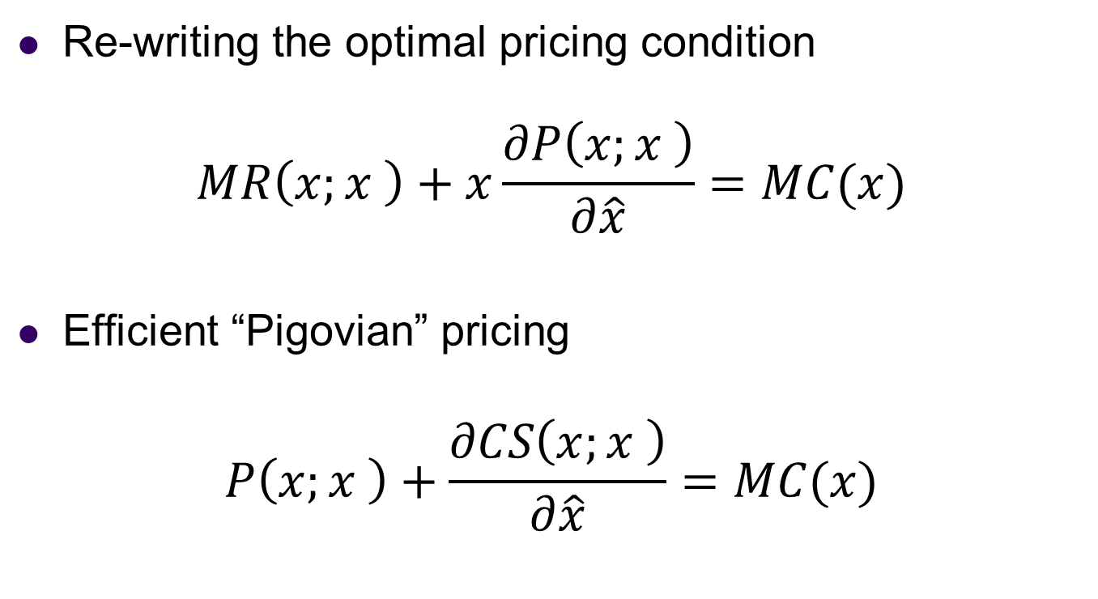
Monopoly vs Efficient Pricing
Re-writing the optimal pricing condition
$$MR\left(x;x \right)+x\frac{∂P\left(x;x \right)}{∂\hat{x}}=MC(x)$$
Efficient “Pigovian” pricing
$$P\left(x;x \right)+\frac{∂CS\left(x;x \right)}{∂\hat{x}}=MC(x)$$

Slide 39
Pricing with Network Effects
Point 1: standard pricing theory applies, set higher prices for groups whose demand is relatively inelastic, or for whom cost of serving is high.
Point 2: subsidize groups of users who create value for other users, and similarly charge users who diminish value for other groups of users.
Point 3: If there is competition, may be optimal to compete aggressively for users who “single-home”, while setting high price for multi-homing users.
Note: ideas similar for “price-like” strategic choices.

Slide 40
Platform Pricing Examples
Google and search engines
  Free for consumers (not just search but additional services: email, translation, analytics, docs).
  Advertisers have to pay, and less “relevant” advertisers have to pay a premium in auction.
eBay, Amazon and e-commerce platforms
  Free for buyers, but sellers have to pay commission.
  Differential value creation? Differential elasticity?
Financial exchanges
  Traders are paid to submit “standing orders”, but have to pay when they submit “crossing orders”.

Slide 41
Summary
Platforms are intermediaries who “make a market” for buyers & sellers, or more generally for users.
High-level view emphasize network effects and important of assembling a user base.
Some key ideas in thinking about platforms
  Coordination problems in assembling users
  Potential for “winner-take-all” and lock-in
  Platform pricing optimally subsidizes users who “create value” for other users, and this logic may lead to very different fees for different user groups.
Next time: look at more examples/case studies.

